Slide 1
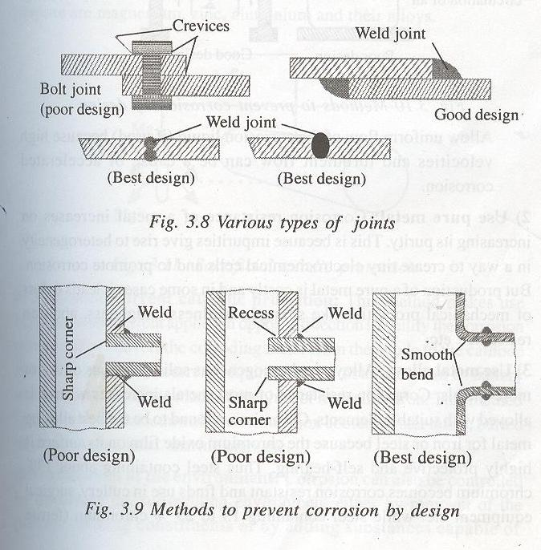
PROTECTION FROM CORROSION
[I] Design and Material Selection

Slide 2
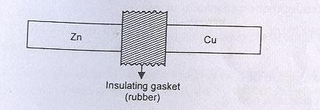
When contact of dissimilar metals is unavoidable, suitable insulator should be inserted between them to reduce current flow and attack on the anode.

Slide 3
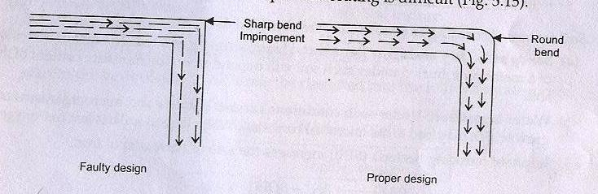

Slide 4
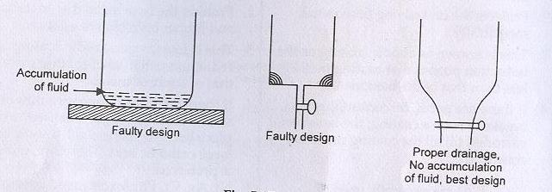

Slide 5
[II] Modifying the Environment
Deaeration
Deactivation : addition of chemicals, capable of combining rapidly with O₂ in aqueous solution
Dehumidification: by using alumina or silica gel
Use of inhibitors
a. By forming a layer in between which acts as a barrier between the material and environment.
b. Or by retarding the anodic or cathodic or both processes

Slide 6
III. Metallic coatings
Electroplating
Hot dipping
Metal Cladding
Metal spraying
Cementation: The base metal articles are packed in the powdered coating metal and is heated to a temperature just below the m.p. of more fusible metal, so that an alloy layer is formed over the surface.

Slide 7
